Slide 1
Data Acquisition and Computing at the Compact Muon Solenoid Experiment
Matt Hollingsworth
University of Tennessee

Slide 2
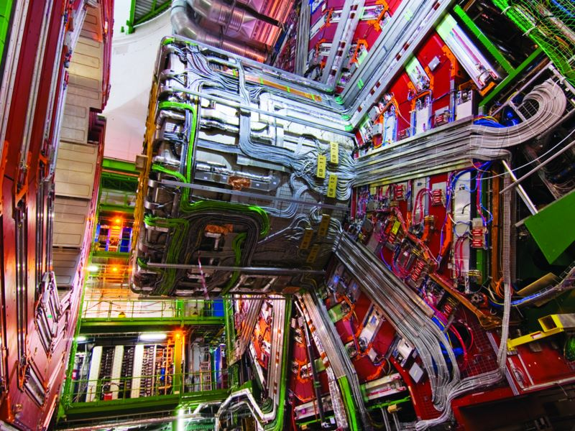
Notes:
I’m Matt Hollingsworth and I work on this ^ detector. I’d like to explain what it does, and how we go from this…

Slide 3
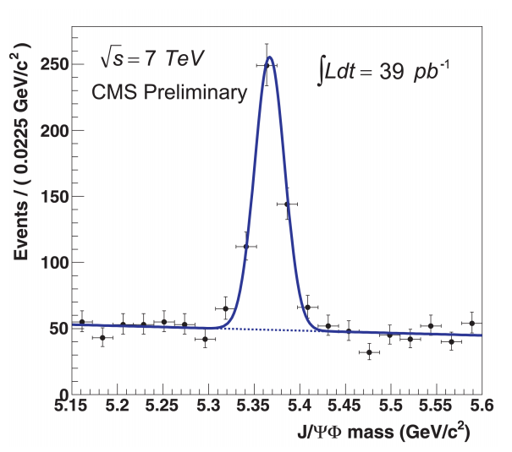
Notes:
to this. So, the general goal here is to follow the life of a particle from its birth in the middle of CMS to a point on a graph in a publication. As a side note, this happens to be a J/Psi mass peak produced at UT by Giordano Cerizza.
There are many steps along the way, but in general, we can distill the process into 3 steps,

Slide 4
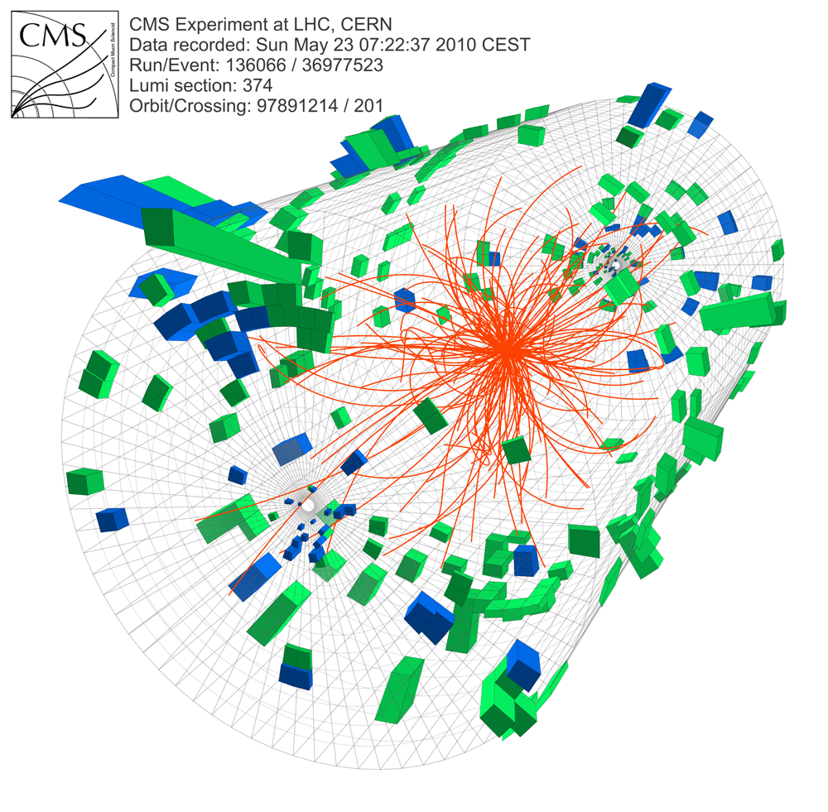
Raw Data
Reconstruction and Filtering
Physics
Notes:
Raw data
- Detector info for processing
Reco and filtering
Raw to physical
Filtering on physical parameters
Physics
-Lots of data, need distributed computing

Slide 5
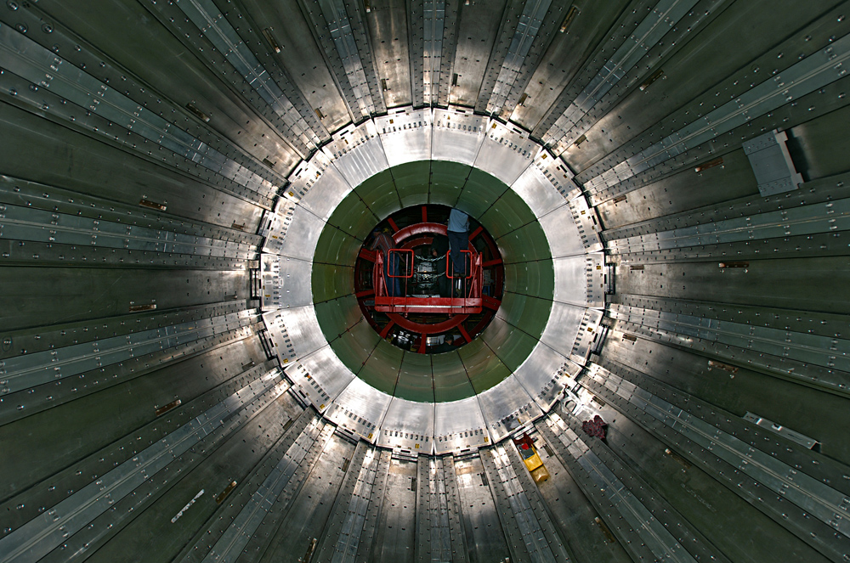
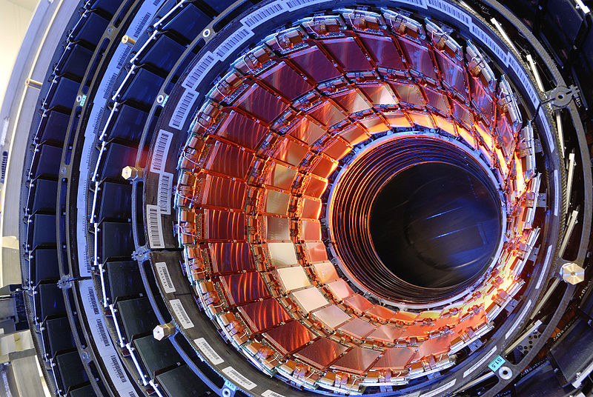
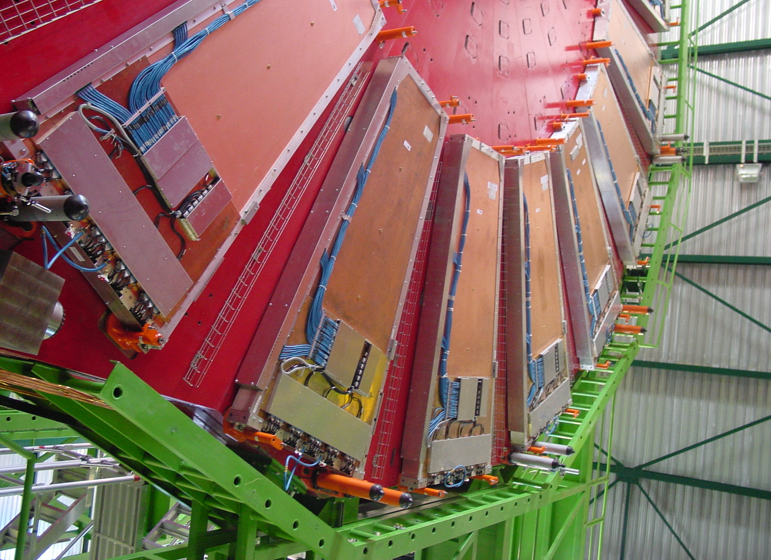
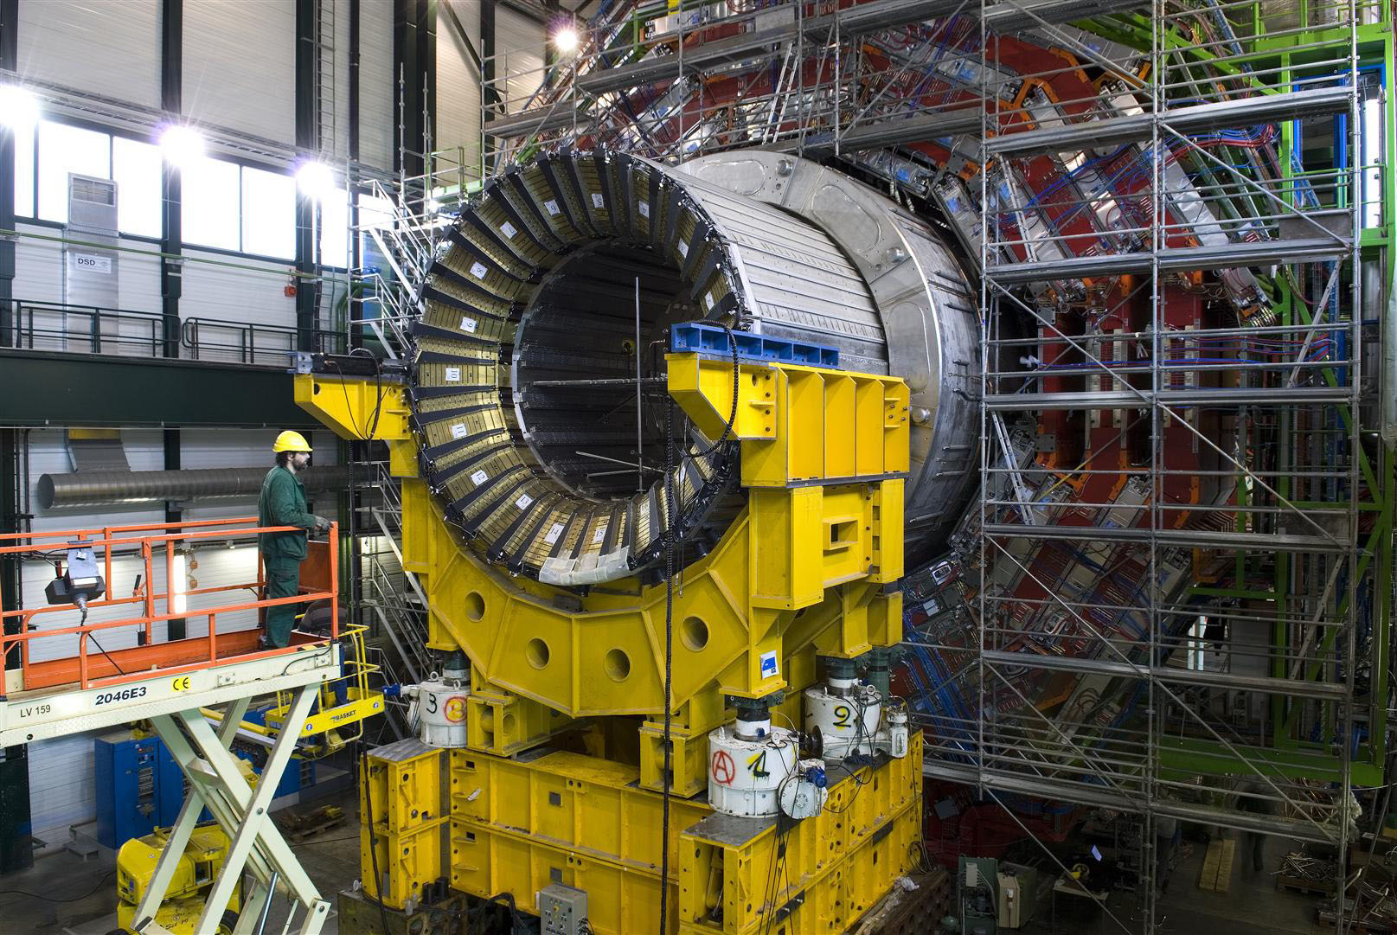
ECAL
Tracker
Over 40 TB/second
HCAL
Muons
Notes:
We start off with Raw Data—things like charge deposit, or simple “this detector was hit” information. This stage produces an enormous amount of data—over 40 TB/second at full LHC luminosity

Slide 6
Need robust filtering strategy
Notes:
Can’t hope to store all of that information, so we need some sort of robust filtering strategy

Slide 7
Smart Trigger
40 MHz -> 100 kHz
How to keep interesting events?
Notes:
Our spec is to reduce the 40 MHz bunch crossing rate to a more manageable 100 kHz trigger rate. It’s not so simple however because this trigger needs to be a smart trigger in the sense that it needs to know which of these events were interesting, not simply that there was a collision. . The problem comes from the fact that the events we are looking for are incredibly rare—for example, the Higgs production rate is expected to be roughly 0.1 Hz. Compared to the event rate of 40 MHz, this is quite literally a 1 in a billion search. We need to somehow quickly look at events and their topology and decide whether or not this event is interesting. Quickly here means not only high data throughput but also very low latency; in fact, the trigger system requires a latency of no greater than 3.2 *microseconds*. So the system needs to deal with these 40 TB of data with a latency of less than 3.2 microseconds.

Slide 8
Raw Data
Reconstruction and Filtering
Physics
Notes:
We need to quickly go from here to the point where these raw data mean something physical, namely tracks with some energy and momentum, during what I’ve called the “Filtering and Reconstruction” stage.

Slide 9
Raw Event Size > 1MB
100 kHz -> 100 GB/s
Still too much
(~8 petabytes/day)
Notes:
Even after the level 1 trigger system, the resulting 100 kHz rate is still too much to store practically; we therefore need to reduce the data volume down yet again to something that we can actually store.

Slide 10
Basic reconstruction in real time
HLT = High Level Trigger
100 kHz -> 100 Hz
(~8 terabytes/day – Manageable)
Notes:
The system that is responsible for this is called the HLT, which stands for High Level Trigger. After the HLT step, we get data at a rate of 100Hz, which corresponds to up to 8 terabytes per day, which is much more manageable. The HLT needs to make even tougher decisions about the level of interest of each event, so it needs even more information that the L1 trigger needs. So the HLT does a basic level of reconstruction—track creation, energy cluster creation, etc.—in realtime, at the full 100 GB/s, 100 kHz rate. From there, it can make a very informed decision about whether or not this event is interesting.

Slide 11
Raw Data
Reconstruction and Filtering
Physics
Notes:
The last step is where we try to take this data and make a publication out of it.

Slide 12
Still > 1 TB/day
Notes:
Even after the reduction, huge amount of data
(N Petabytes and counting)
Need distributed framework to handle all of this data.

Slide 13



Notes:
The particular distributed computing environment that we settled on is the Grid. In particular, we use two grids primarily at the LHC, EGEE (Europe) and OSG (everywhere else). They can communicate because they both implement the standards set down by the Open Grid Forum.

Slide 14
Raw Data
Reconstruction and Filtering
Physics
Notes:
Now we’ll go into the detail about the raw data step, and I’ll start of with a very brief overview of the CMS detector and what it does.

Slide 15
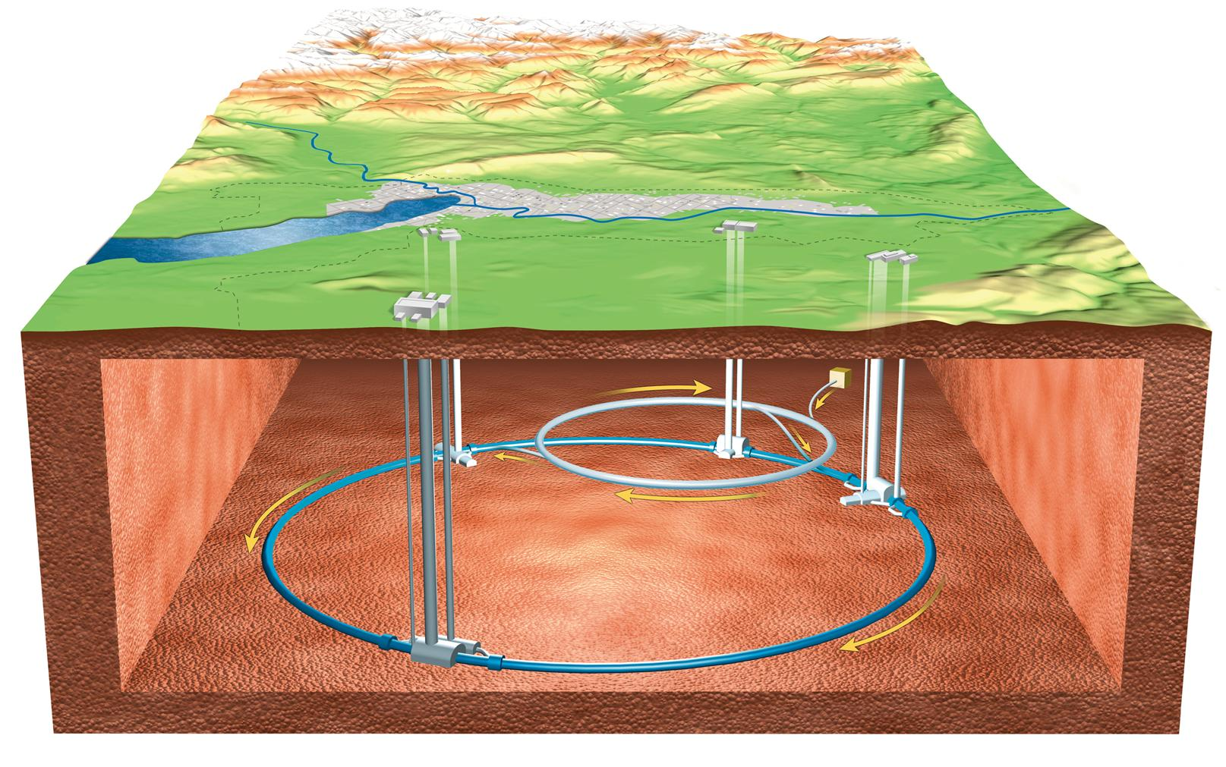
The LHC
CCC
Main CERN Site
LHCb
ATLAS
ALICE
LHC
8.6 km
(27 km circumference)
CMS
Notes:
Here is the LHC. It’s 50 m underground, and 27 km in radius. The LHC actually recycled the old tunnel for the LEP (Large Electron-Positron Collider). Each of these labeled names are detectors on the ring… I will be discussing CMS.
World Wide Web was born here (in particular, the first web server)
It has the highest collision energy in the world, and therefore brings with it significant challenges.

Slide 16
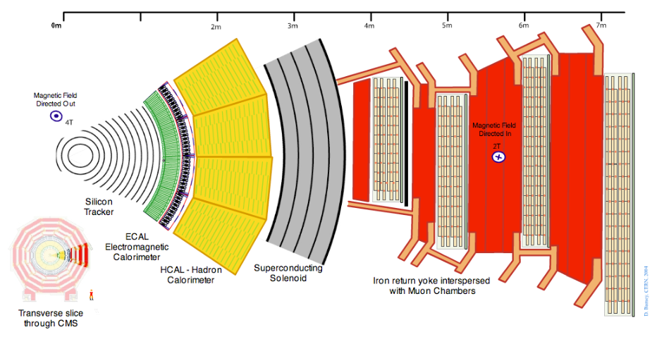
Notes:
CMS is arranged concentrically. The tracker in the middle, which is responsible for (as it may sound) finding the particle paths as they go through the detector. Directly outside that is the ECAL (Electromagnetic Calorimeter), responsible for capturing the energy deposited from more or less electrons and photons. Outside of that is the HCAL (Hadron Calorimeter). After the calorimeters comes the 4 Tesla solenoid (CMS’s namesake), and finally the muon chambers (it’s other namesake).
That axis at the top says 7 meters, so CMS is nearly 30 feet in radius, i.e., it’s quite large.

Slide 17
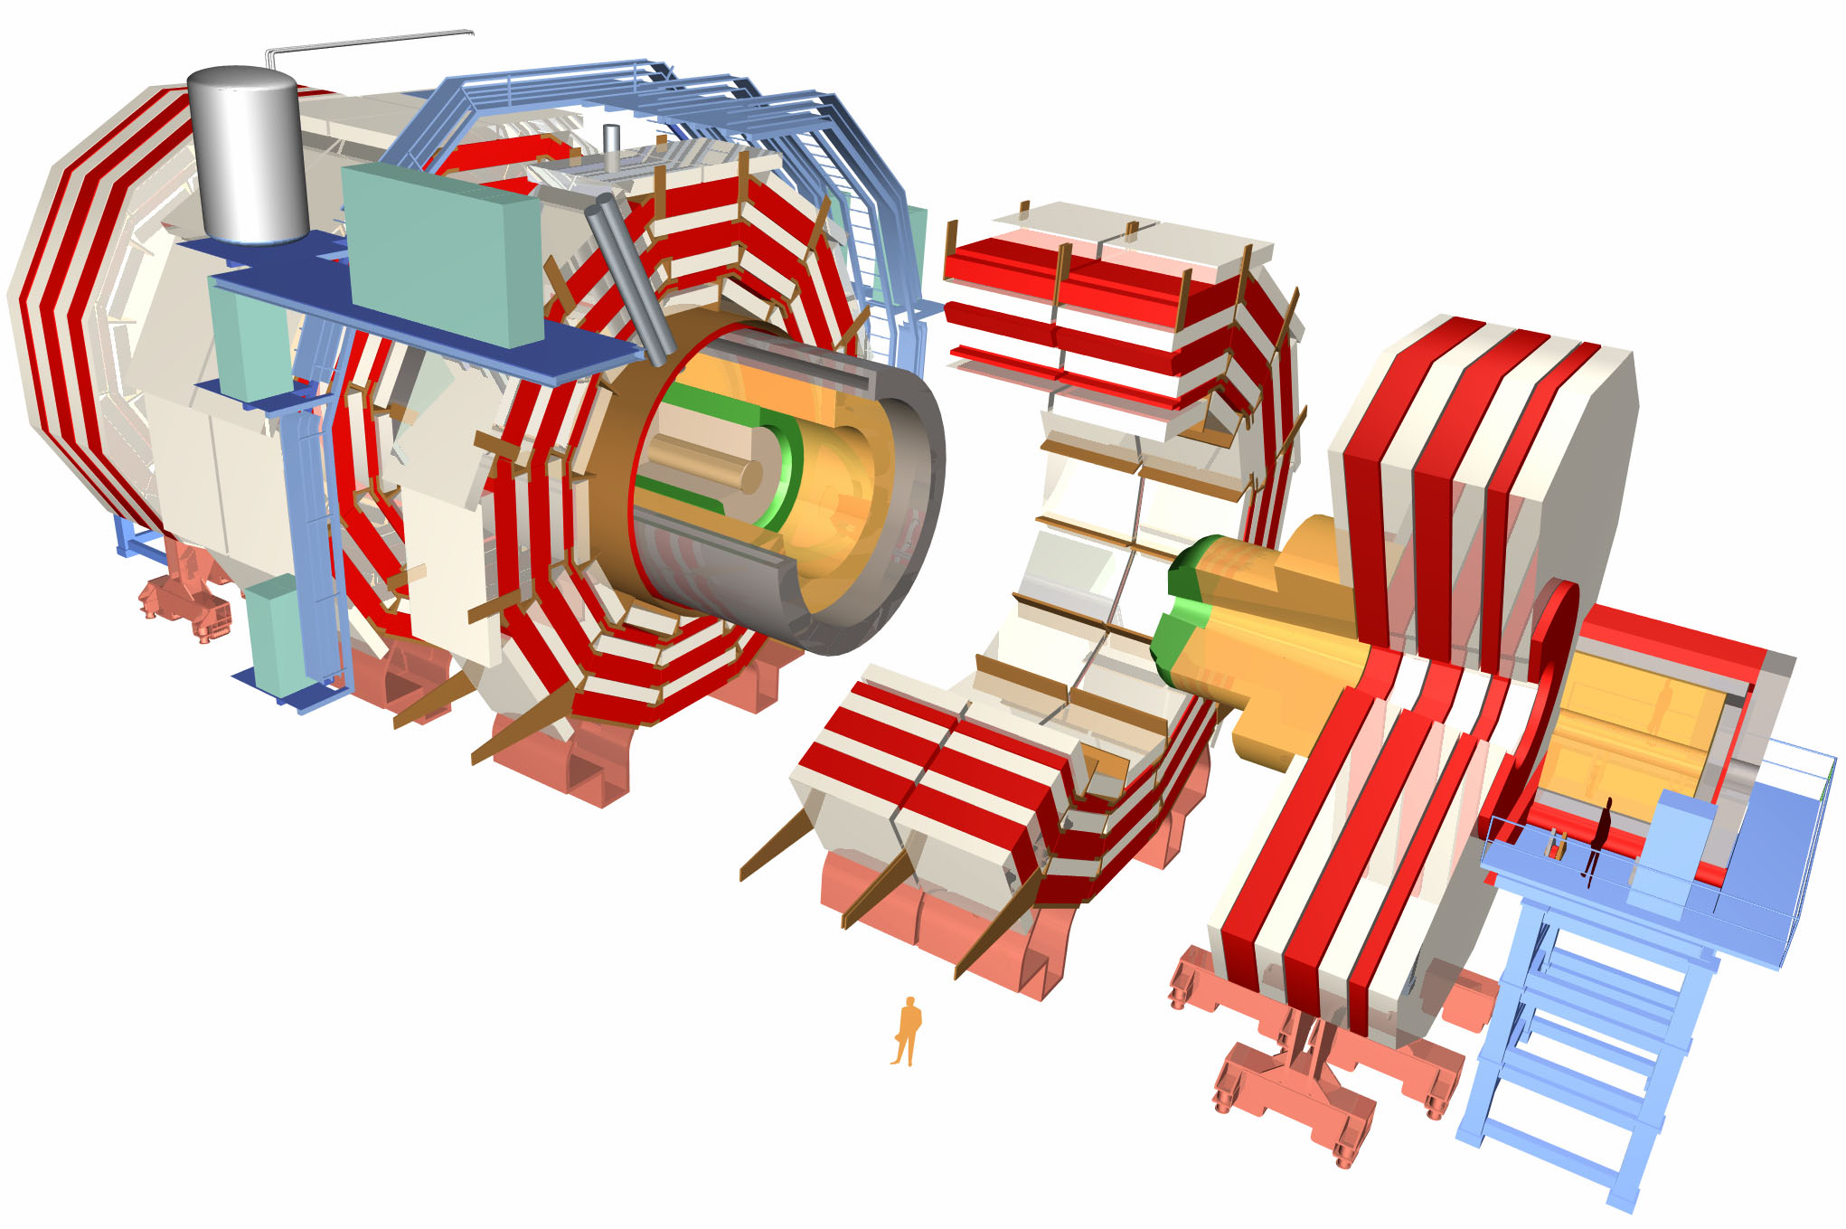
Notes:
Just to provide a different perspective, here’s a blown up 3D model of it. If you look on the blue platform, there’s a person standing there to give it some scale.

Slide 18
ECAL
Tracker
HCAL
Muons
Notes:
So, we have these 4 subsystems, and I’ll just be talking about 1 of them: The tracker. There are multiple reasons for this, but the two main ones are that it has the most daunting data concerns and it’s most directly related to my personal research topic, so I know the most about it ☺

Slide 19
Case study: Tracker

Slide 20
66,000,000 Pixel Channels
10,000,000 Strip Channels
Max Trigger Rate: 100 kHz
Notes:
6.6*10^7 * 10^5 = 6.6*10^12 pixels/second

Slide 21
Can’t read out 66 million channels every 25 ns
-> Level 1 Trigger
Notes:
As we mentioned, can’t read out every bunch crossing
Need trigger system to bring down data volume

Slide 22
Muons
L1
… in < 3.2 us
Calorimeter
Notes:
“Level-1” trigger: The trigger that is sent to the hardware
It’s smart: Makes decisions based on the topology of the event
Needs to be really fast though; needs to decide in < 3.2 us whether or not the event is interesting

Slide 23
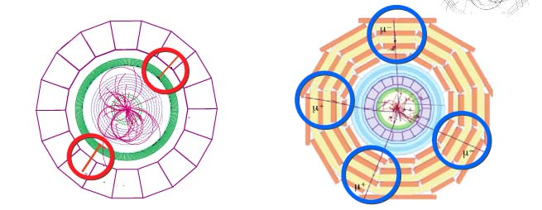
Calorimeter
Relatively simple cut on scalar
Muons
Clean signal
Notes:
Muons and calorimeters only go into the L1 trigger—no pixel or strips
Muons: Since the only particles that reach the muon detectors are muons, the signal is clean and therefore makes for an efficient trigger
Calorimeters are relatively easy to read out, since it reads out a scaler and nothing else
Good example of using the situation to decrease computing demand

Slide 24
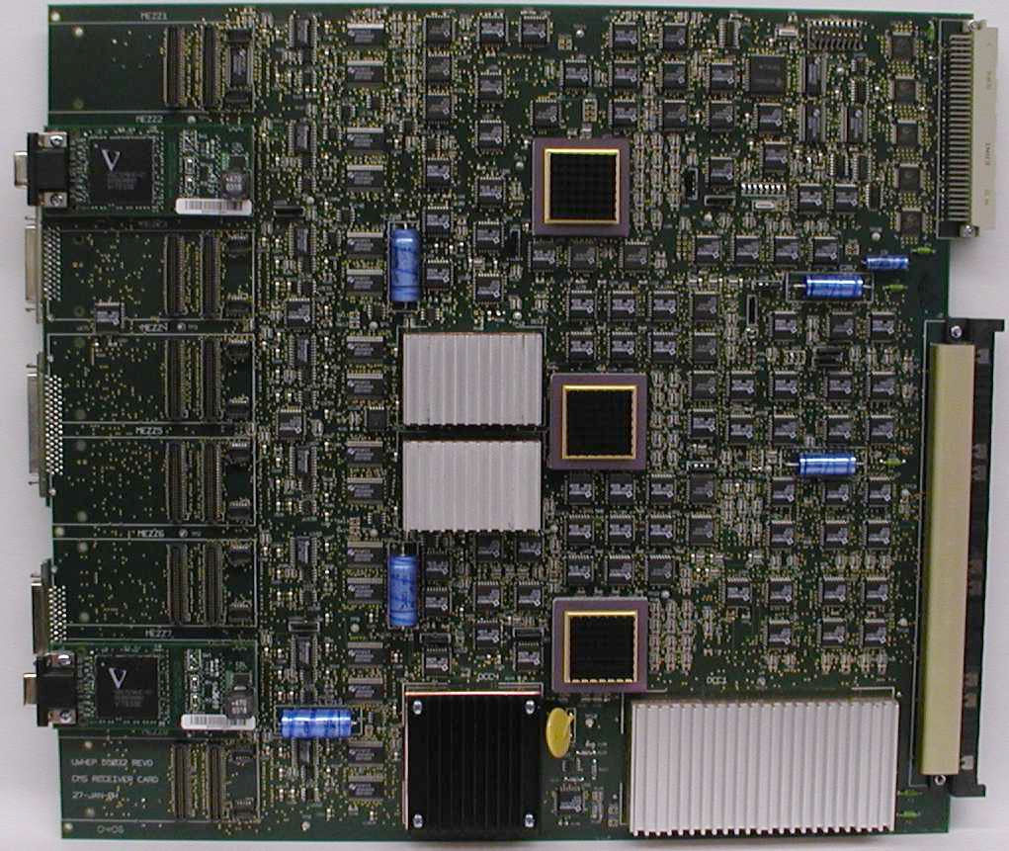
3.2 us-> ASICs and FPGAs
Notes:
Solution for L1: “Software implemented in hardware”
Good example of CMS making line between software and hardware blurry
Sometimes, hardware based solutions can bring you a long way
FPGAs/ASICS: “Programmable Electronics”
VME: Unified readout electronics
CMS Paradigm: Program your FPGAs to do the number crunching when it needs to be really fast, ship results to compute farm

Slide 25
T
Trigger
Interaction
3.2 us = 128 events later
Circular buffer of 128 events is necessary in case event is interesting
Notes:
The 3.2 us trigger latency is hard enough to comply with, but then every single detector then has to worry about keeping up with all 128 events that happened during that trigger latency time because they don’t know which events will turn out to be interesting after all.

Slide 26
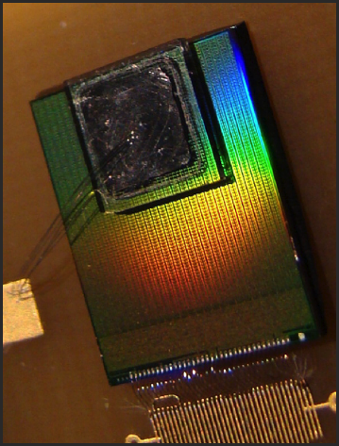
This is actually diamond
CMS uses Si
PSI46
52 x 80 pixels = 4160 pixels
8 mm x 8mm
Notes:
This is how the pixel detector solves this problem.
Interesting things about the PSI46 chip:
Reads out at 100 kHz
Zero Suppression
Encodes pixel hit info digitally
Keeps every event that comes to it, up to a few hundred (according to complexity)
Pixel detectors are very much like CCD cameras—except cameras that can take 40 million pictures per second.
The readout is very different however. Cameras query each pixel and ask how much charge was deposited in any given pixel. This is a camera where the pixel itself knows whether or not it was hit or not. For us, if the pixel isn’t hit, it doesn’t enter the readout chain at all, and therefore doesn’t waste time at the readout level.
Every single hit that the ROC gets (for the last 128 events at least, it’s actually more, but that’s the spec) is buffered, but not necessarily read out. Instead, the chip waits for a trigger, after which it grabs the event in its buffer that it thinks corresponds to the physics that the trigger got excited about. This is done through a programmable parameter called the WBC, which basically tells the chip what index to look at in the buffer when it gets a trigger—it sets the phase between the trigger and the sliding buffer window.

Slide 27
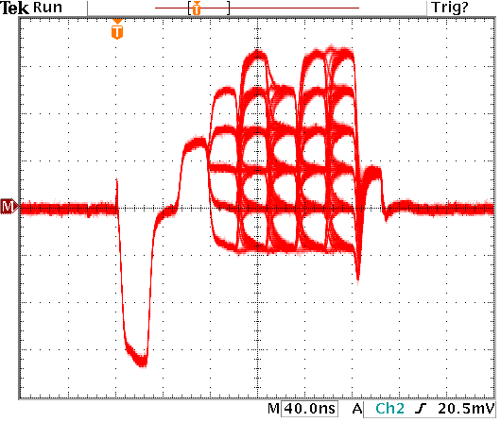
Hit coordinate in base-6
(fewer necessary clocks)

Slide 28
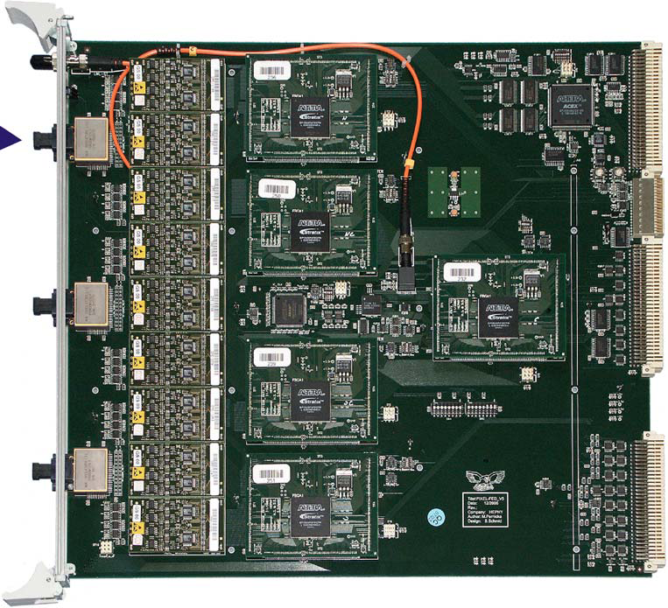
Pixel FED (Front End Driver)
Notes:
The FED takes the output of a ROC into 1 of its 36 channels and uses an internal state machine to process it. So by the time it gets done decoding one hit, it has in its memory the row, column, and an adc which is proportional to the charge deposit in the pixel. It’s this information that gets shipped onward down the chain, nothing else. (well, there are some status bits and such like, but not any other data)

Slide 29
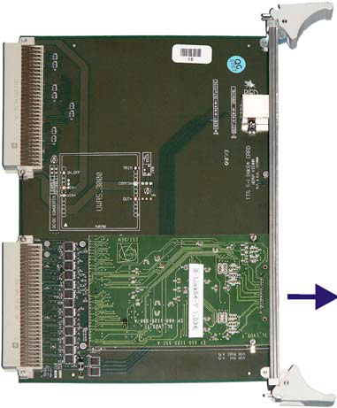
S-Link
VME card
640 MB/s throughput
Commercially available
http://hsi.web.cern.ch/HSI/s-link/
Notes:
The FED ships its data out on what’s called the S-Link, which is a high throughput card which hooks to VME backplanes.

Slide 30
Reconstruction
and Filtering
Raw Data
Physics
Notes:
Now we come to the Reconstruction and Filtering stage

Slide 31
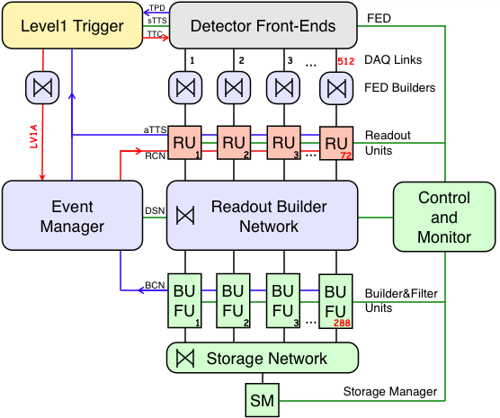
S-Link
Proccesing
(Server Farm)
High level Trigger (HLT)
(post-reco filtering)
Deep Storage
Notes:
The Slink is “the” output of the frontend readout electronics—now we need to synchronize and process the data. This is done in an online DAQ server farm, referred to as the Event Builder. The event builder passes its data to the HLT to decide whether or not to keep the data that it comes up with and if the HLT says yes, it’s passed to deep storage.
Requires equipment which can process 100 kHz and not get backed up
HLT decides whether event is interesting enough to save to deep storage
Solution: Parallelization

Slide 32
Slink
Notes:
This is an overview of the Event Builder—we’ll go through each step in detail.

Slide 33
Slink
Notes:
FED Builders
Each FED outputs its own fragment of the event
FED Builder is responsible for syncing 8 FED outputs and combining them into a “Super Fragment”
FED Builder’s responsibility: Get Hardware Raw Data into Myrinet
This is happening at the L1A rate (100 kHz still) so throughput is 100 GB/s
This is not exactly an “embarassingly parallel” problem—the issue is that yes, it’s parallel, but they need to stay in sync, i.e., each member of each of these FED builders is in some way dependent on the others.

Slide 34
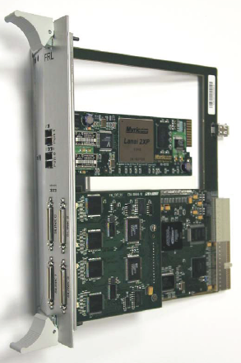
S-Link
Frontend Readout Link (FRL)
- CompactPCI backplane
- Custom S-Link Comsumer
- Commercial Myrinet NIC
Notes:
FED Builder is our answer to traditional “DAQ computer”
Implemented in CompactPCI with custom card (FRL) which takes data from S-Link and dumps it to commercial Myrinet NIC
Destination logic (network routing) is implemented in Myrinet NIC’s RISC processor
Total network throughput: 2 Tb/s

Slide 35
Readout Units (RUs)
Notes:
RU’s (readout units) take data directly from the FED Builders (Myrinet) and buffer it
These are linux PCs
RU’s arranged into 8 completely independent “DAQ slices”; RU plays role of gatekeeper
Holds the data until it’s requested (pulled) from further down the chain
Tells the Event Manager that it has event number X
Event manager then knows where to find all pieces (Super Fragments) for an entire event
EVM also asks the trigger system for its own special super fragment

Slide 36
Builder and Filter Units
(BUs and FUs)
Notes:
BU = Builder Unit
FU = Filter Unit (HLT)
BU’s are responsible for combining the super fragments into a full event
BU’s tell the event manager that they have resources
Event manager then tells BU a list of RU’s which have the pieces of the event to assemble
BU pulls data from these RU’s and builds it
Resulting (full) event is then forwarded to the HLT farm for filtering

Slide 37
Still 100 kHz--100 GB/s is too much to store
-> High Level Trigger (HLT)
Notes:
HLT is responsible for picking the interesting events from this group of events
Reduces to a more manageable 100 Hz

Slide 38
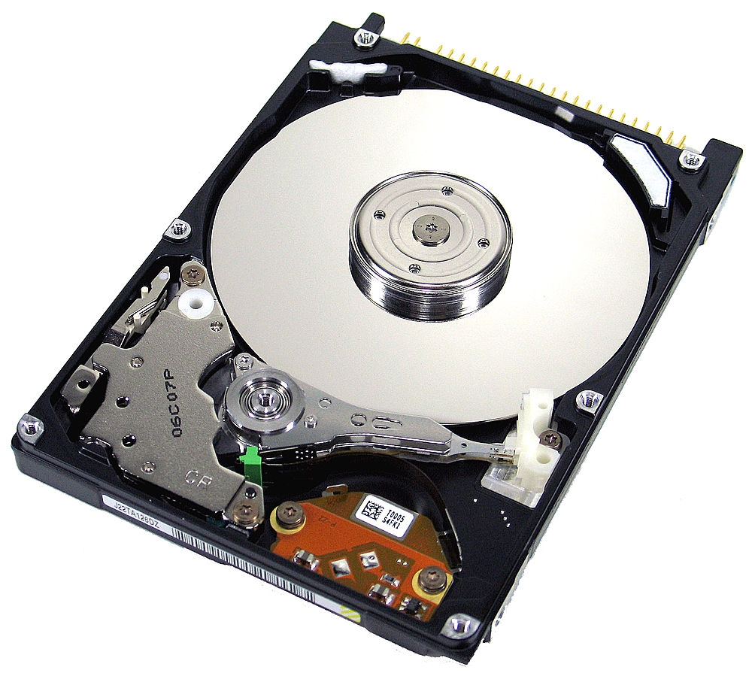
Interesting?
Yes
No
Ignore
HLT

Slide 39
Filtering Units (FU) = HLT
Notes:
HLT
This is where the physics starts
Event is mostly reconstructed—tracks are made, energy deposit clusters are formed, etc.
From the resulting topology, it’s decided whether the event is interesting enough to keep

Slide 40
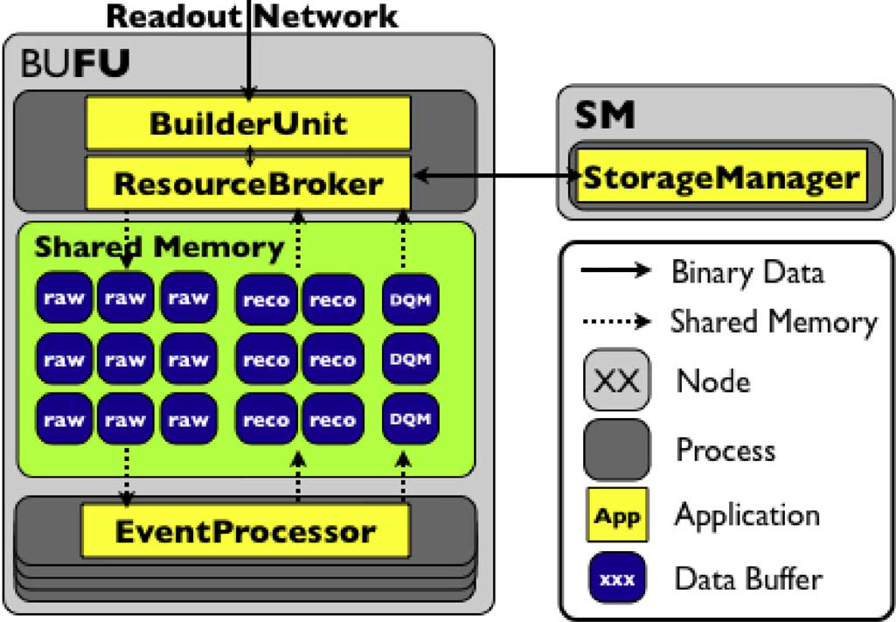
Notes:
FU’s consist of two independent apps: Resource Broker, which transfers the event data from its associated Builder Unit (BU) and EventProcessor, which runs the reconstruction code for each event. They communicate via a shared memory queue.
To save computing power, the simplest (and least computationally intensive) reco processes are run first, and if the event fails to pass those, processing is terminated.
If the event is interesting enough, then info that the HLT used to make its decision is added to the event and the whole event is passed on to the Storage Manager

Slide 41
Reconstruction and Filtering
Raw Data
Physics
Notes:
Now we come to how physicists use this stored data to produce publications.

Slide 42
✓
?

Slide 43
CMSSW
Notes:
Now we’re in deep storage. Now we need some way to analyze all this data that we’ve produced. Enter CMSSW, the CMS software for data analysis

Slide 44
CMSSW
Path
Digitizer
Tracker
Ntracks
Filter
Mass
Source
Event
Path 1
…
Path N
Output
Module
Notes:
This is an overview of the architecture of CMSSW. We’ll break this down into the main components…

Slide 45
Source
Digitizer
Tracker
Stored Event
Data Producers
Add to event (never allowed to modify previous content)
Generic input source
(mass storage system typically, eg. dstore)
Ntracks
Filter
Mass
Analyzer
E.g, histogram producer
Data Filter
Should path continue or terminate?
Output
Module
Output Module
Saves the data to some storage
Notes:
Each of the things that I describe here are basically a separate class in CMSSW (it’s implemented primarily in C++)
Source: A generic input source whose sole purpose is to provide events to iterate over.
Data Producer: Reads in the event data and appends its own data to the event stream. It isn’t allowed to modify anything in the event, only add to it. This is important since we need to be able to, at any point, discover exactly what our analysis is doing
Filter: Looks at previously injected data and decides whether or not this event is interesting. If the answer is no, processing is halted immediately for the event so that subsequent producers or analyzers are never called on uninteresting data.
Analyze: Read-only event consumer, which typically produces things like histograms or Ttrees
Output Module: A generic output module, analogous to the Source—in fact, if you save the results of a path to file via the output module, you can use it again as an input source. This particular use case is important because it allows you to create “skims”, selections of the data with reconstructed information in them. These are typically much, much smaller than the master dataset, and can therefore be processed on university-sized compute clusters.

Slide 46
CMSSW
Path
Digitizer
Tracker
Ntracks
Filter
Mass
Source
Event
Path 1
…
Path N
Output
Module
Notes:
Here’s how everything fits together.

Slide 47
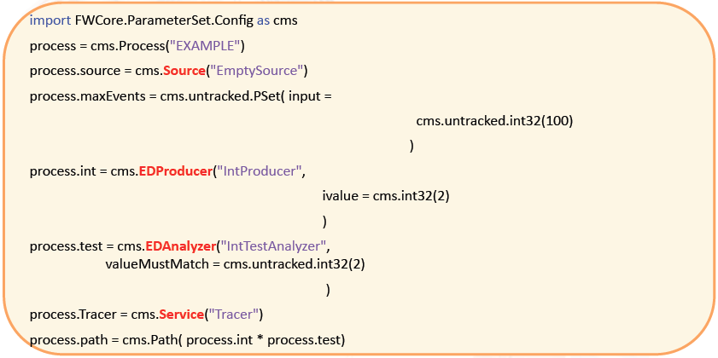
Notes:
Independent analyzers are chained together into Paths, and Paths into Sequences, etc. by a python “Config File”, which is really just a python program where 99% of the work is done outside the file (usually). Uses boost::python for the bindings.
Another important feature of CMSSW is that it keeps up with all of the config files that were run for a particular data run inside of the output files. This lets you introspect an analysis output file to figure out exactly what code was used to create it. This is critical when running complex analyses.

Slide 48
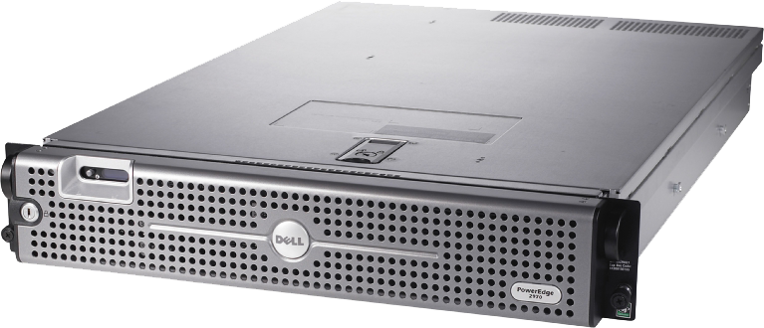
Event-level parallelization
Events
Notes:
Events are assumed to be disjoint
This model allows for per-event parallelization
No time-ordering
Each event can be analyzed in different process

Slide 49
Worldwide LHC Computing Grid (WLCG)
Based on Grid architecture

Slide 50
Electrical
Grid
The Grid
Transparent access to resources
Pooling of resources
Notes:
No way to explain grid architecture in my remaining 15 minutes, so I’ll settle for a simple analogy.

Slide 51
Two Grids Used at CERN
EGEE in Europe
Open Science Grid (OSG) elsewhere
Notes:
Enabling Grids for E-sciencE
EGEE:
Uses gLite
>40,000 CPUs
Several petabytes of storage
OSG:
Uses Open Science Grid Software Stack
Both software stacks include common pieces of software, such as Condor, Globus, etc.

Slide 52
CMS Online
(HLT)
Raw
Tape
Analysis,
Selections
Tape
First Pass
RECO
Tier-1
Tier-0
Hard Drives
(Skims)
~140
sites
Tier-2
Notes:
Tier-0 is CERN, the first place where all the data Is archived. A basic reconstruction is done there (track finding, cluster finding, etc.) and then replicated to all of the Tier-1 centers, of which there are 11 at the moment (see list below). The Tier-1 centers are the main user interface to the big data, and include places like FNAL. It is here that “pre-analyses” are typically done, where people make a relatively loose preselection of the data, take the variables they care about, and dump it into a (now smaller) file so that it doesn’t take so long to run analyses.
Tier-1 sites
Canada TRIUMF
Germany KIT
Spain Port d'Informació Científica (PIC)
France IN2P3
Italy INFN
Nordic countries Nordic Datagrid Facility
Netherlands NIKHEF / SARA
Taipei ASGC
United Kingdom GridPP
USA Fermilab-CMS
USA BNL ATLAS

Slide 53
Standard Grid Services
CMS-Specific
Services
Batch Queue
File Transfer
Auto Job Creation
(CRAB)
Tiered File Transfer
(PhEDEx)
+
Security
Storage
Data Discovery (DBS/DAS)
Notes:
Batch Queue: Condor, TORQUE
File Transfer: GridFTP
Security: VOMS
Storage: dcache, lustre…
Crab: Handles splitting up the event into separate jobs and figuring out how to properly submit them
PhEDEx: Handles transferring data between sites
Data Discovery: Keeps up with all of the thousands of files produced and associates them in to hierarchical datasets.

Slide 54
Data Aggregation Service (DAS)
and
Data Bookkeeping System (DBS)
Notes:
This allows people to make datasets—basically analogous to folders—to contain all of the files which have been produced for a particular analysis, MC generation, or raw/reco detector data. These services provide the user with all the information necessary to datasets they’re looking for, and they provide CMSSW with all the information on how to find the actual data when a user requests to run over a given data set.

Slide 55
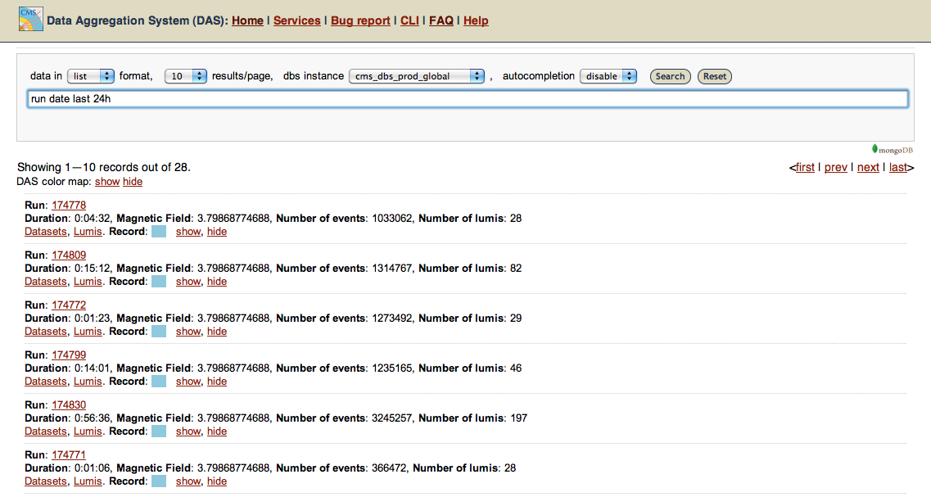
Notes:
This is an example of the web interface that I, a physicist, would use to discover datasets (see my query: all the runs in the last 24hours)

Slide 56
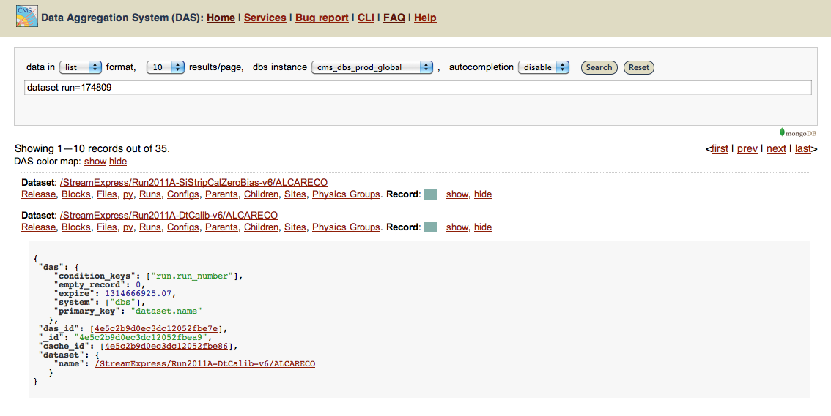
Notes:
And this is what it provides if you ask it to provide a JSON representation of the data. This JSON representation is all the CMSSW needs to know to find the dataset to run over.

Slide 57
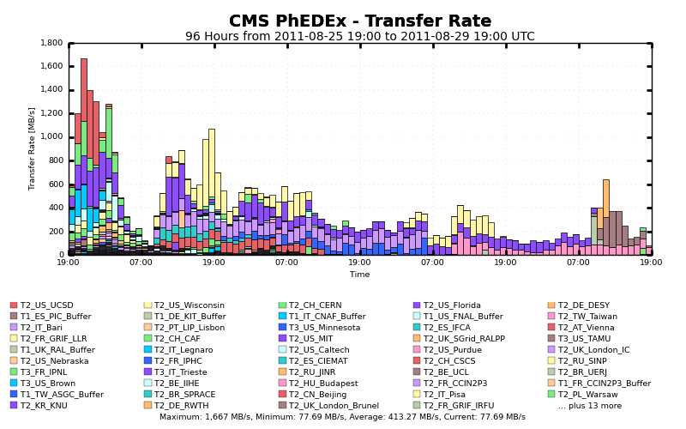
Notes:
PhEDEx deals with shipping the data around

Slide 58
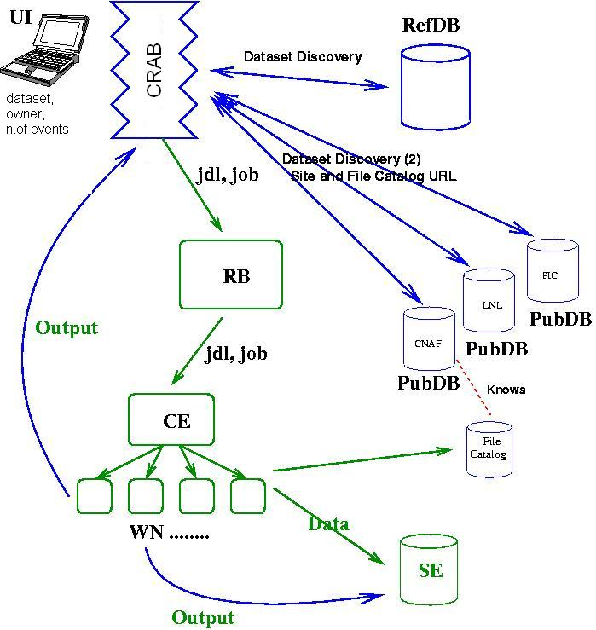
CRAB (CMS Remote Analysis Builder)
Notes:
Built on top of Grid Batch Queue
CRAB automatically parallelizes your config file. All you needs is a CMSSW config file, a JSON file (to tell where to find the data) and a crab config file which tells crab how many compute nodes you’d like to run on, where you’d like the results to be placed, etc.

Slide 59
Notes:
so that’s it! We’ve come from the birth of a particle inside of CMS to the point where a physicist can make a publication from the data. That’s the end of the line for the particle, and the end of my talk, thanks for coming.

Slide 60
Thanks!

Slide 61
Grid Implementations and middleware
Advanced Resource Connector (NorduGrid's ARC)
Berkeley Open Infrastructure for Network Computing (BOINC)
Globus Toolkit
Sun Grid Engine
ProActive
UNICORE
SDSC Storage resource broker (data grid)
gLite (EGEE)
NInf GridRPC
IceGrid
Java CoG Kit
Alchemi
GridGain
gridGISTICS
Gridbus Middleware
Vishwa
UGP
GRIA

Slide 62
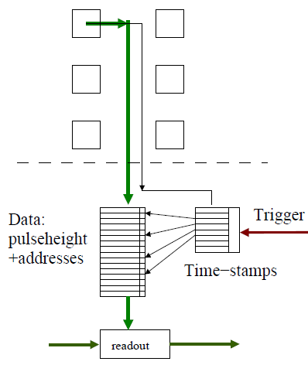
PSI46 Readout Chip
DCOL
Readout Scheme
Every 25 nanoseconds, each pixel checks for a hit (charge deposit) above a programmed threshold
If one is found, the charge, address, and time is pushed into a buffer associated with that pixel
If the system is triggered, the buffer which corresponds to that time is read out

Slide 63
Charged Particle Detection
General principle: as charged particle passes through matter…
Excitation, ionization, bremsstrahlung
Cherenkov light
Transition radiation
Typical detector scenario
charged particle → ionization → free charges → amplification → signal
charge
width
E
HV
 B field

Slide 64
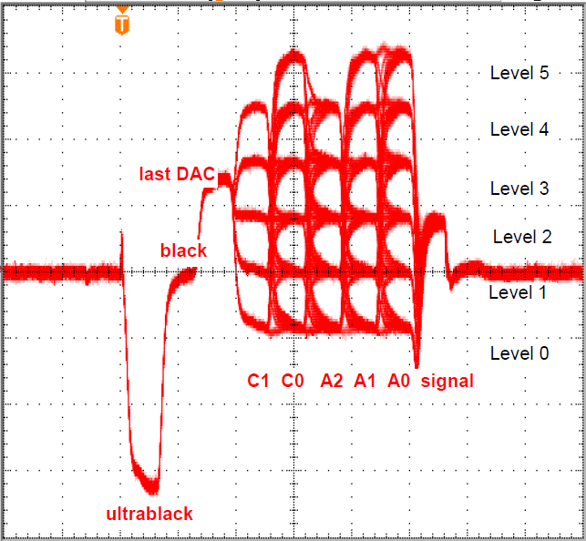
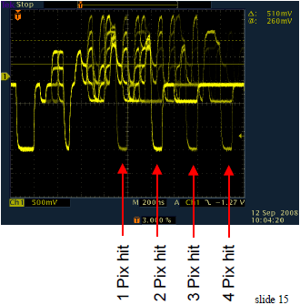
Readout Waveform
Level of C0, C1->Encoded Column Information
Level of A0, A1, A2-> Encoded Row information
Signal is proportional to charge deposit (needs to be calibrated)
~25 ns time bins

